Slide 1
Hockey Stadium Project
Presented By: Sijan Dahal & Yaman Pandey
Group 4
Date: Nov. 25, 2024
MET-625, Advance Project Management

Slide 2
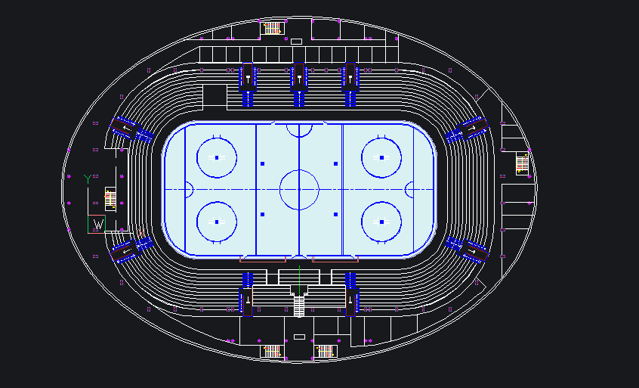
Project One Pager
Project Name
Hockey Stadium Construction Project
Project Lead
Budget
Yaman Pandey/ Sijan Dahal
$5 Million
Project Goal
Construct a 5000 seated hockey stadium in MNSU
following all the university codes.
Pictures
Project Scope
To build a 5,000-seated stadium at Minnesota State University, Mankato. The stadium would consist of Locker Rooms for both male and female players and an indoor training facility for the home team to train in during the off-season.
Project Benefits or Risks
Gives Chance for Mavericks team to host the game
Boosts internal tourism in Mankato.
Gives oppurtunity for local players.

Slide 3
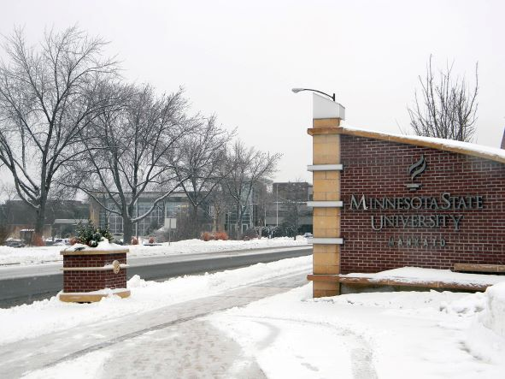

Project Description
With the current hockey stadium designated as a historical landmark, MSU is building a new, sustainable hockey facility on or near campus. The stadium will align with the university’s “Sustainable Campus” vision, incorporating eco-friendly design, construction, and operations while supporting MSU’s championship legacy.

Slide 4

Key Features

Slide 5
Key Features
Hockey Stadium
Locker Rooms
Ice Rink
Seating Zone
Technology
Separate male/female facilities with bathrooms and TVs.
High-quality rink designed by Everything Ice.
General, VIP, accessible seating with amenities.
High-speed internet, digital scoreboard.

Slide 6

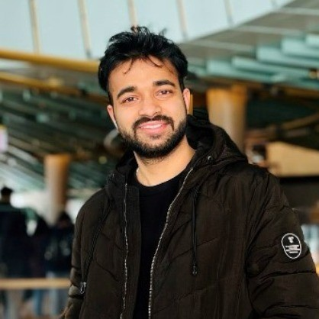
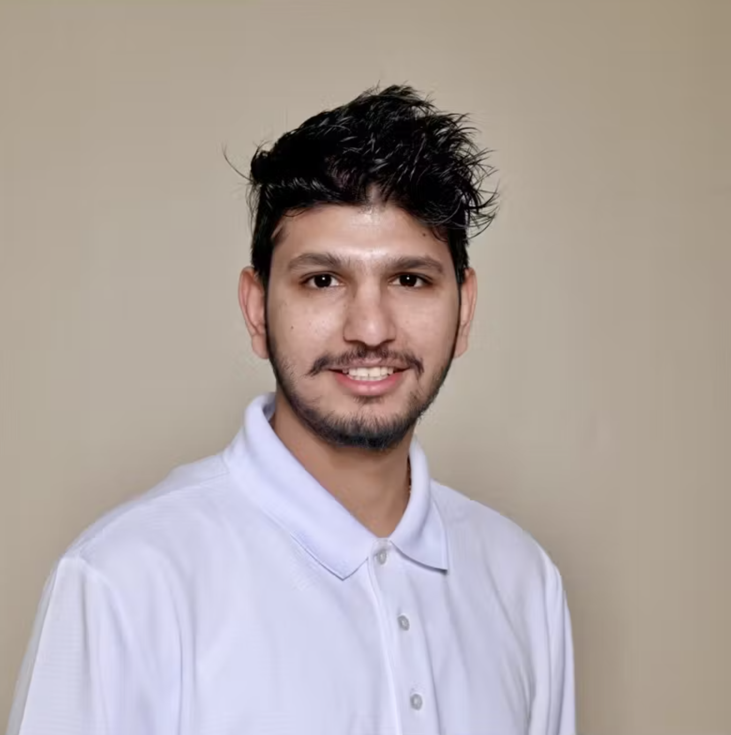
Team Members
Yaman Pandey
Sijan Dahal
Masters of Science in Manufacturing Enginering Technology
Masters of Science in Information Technology
Bachelors of Science in Mechanical Engineering
Bachelors of Science in Information Technology

Slide 7
Table of contents
01
02
03
04
Project Definition
Project Plan
Project Execution
Project Closure

Slide 8
01
Project Definition
Goals: Construct a new hockey stadium to replace the unavailable Mayo Clinic Health System Event Center.

Slide 9


Tasks
Design
Construction
Resource allocation
Testing and Quality Control

Slide 10
Specifications
Arena Size
Seating Capacity
200 ft x 85 ft
5,000 People
Budget
Completion Date
$50 million
October 2027

Slide 11
Technical Specifications
Ice Rink (NHL Standard)
Scoreboard
Dimensions: 200 ft x 85 ft
Ice Thickness: 1 inch (2.5 cm)
Cooling System: Provided by Everything Ice to maintain 22°F ice temperature
Safety: Protective glasses and barriers for spectators
Lighting: Proper visibility for day and night play.
Size: 20 ft x 10 ft
Resolution: 1920 x 1080 pixels
Real-time Data: Updates for goals, misses, and cards

Slide 12
Technical Specifications cont.
Electrical Installments:
(Heating, Ventilation and
Air Conditioning) HVAC
NFPA Codes
NFPA 70 (Electrical Wiring)
NFPA 70B (Equipment Maintenance)
NFPA 70E (Electrical Safety)
NFPA 110 (Emergency Power)
ASHRAE 62 Code: Ventilation for acceptable indoor air quality

Slide 13
Milestones and objectives
Construction Start
Ice Rink
Installation
Design Approval
Testing & Handover
Nov 2025
Jan. 2026
Dec. 2025
Oct. – Dec. 2026

Slide 14
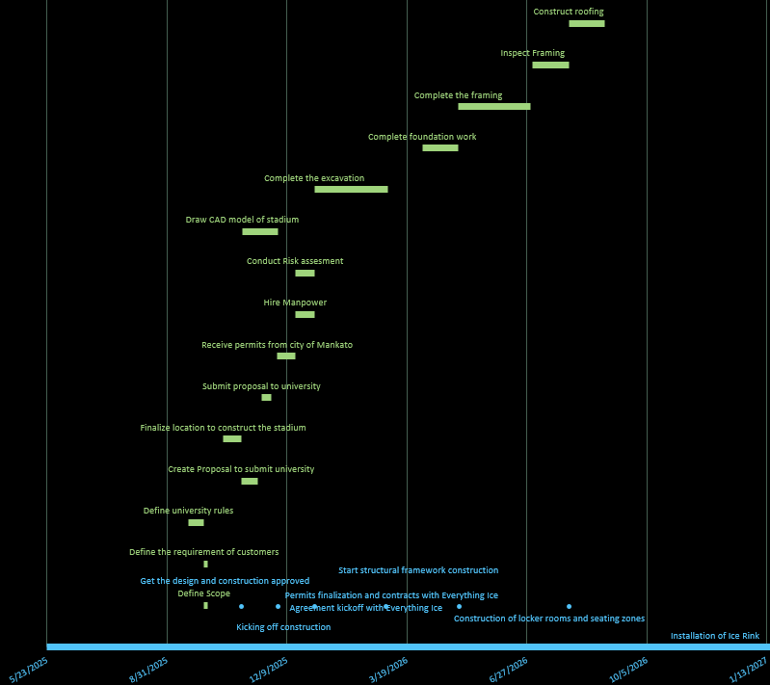
Gantt Chart

Slide 15
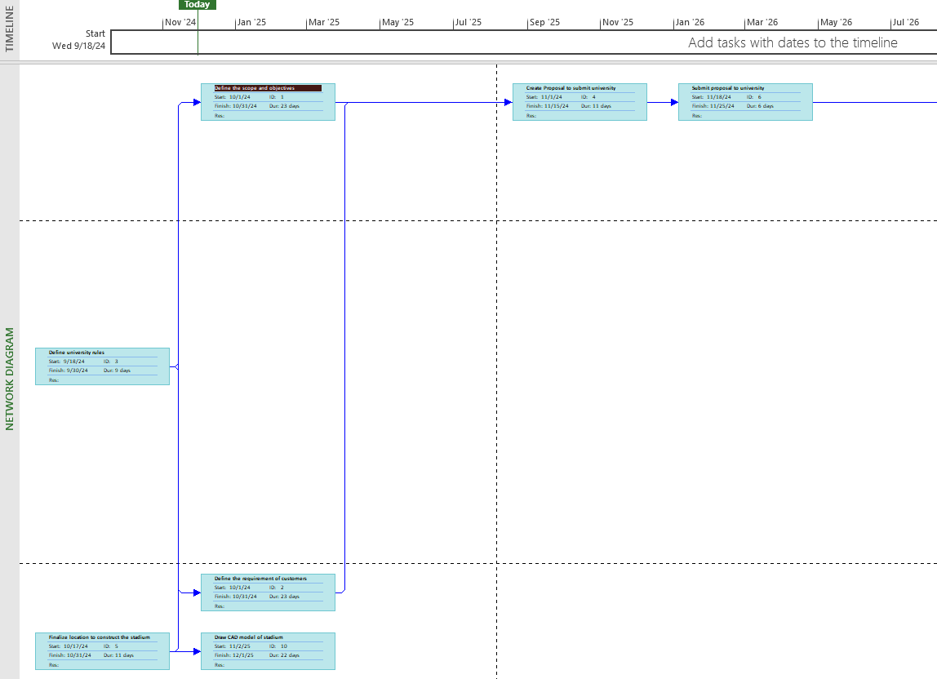
Network Analysis

Slide 16
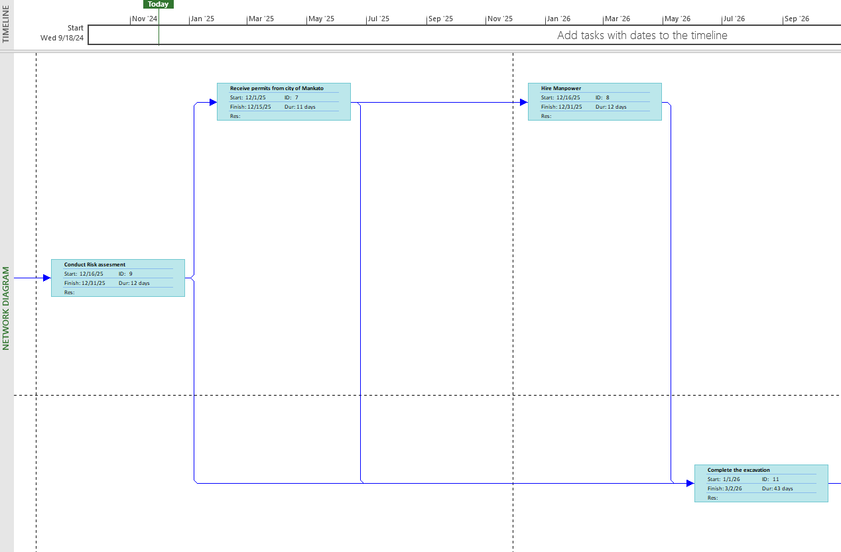
Network Analysis

Slide 17
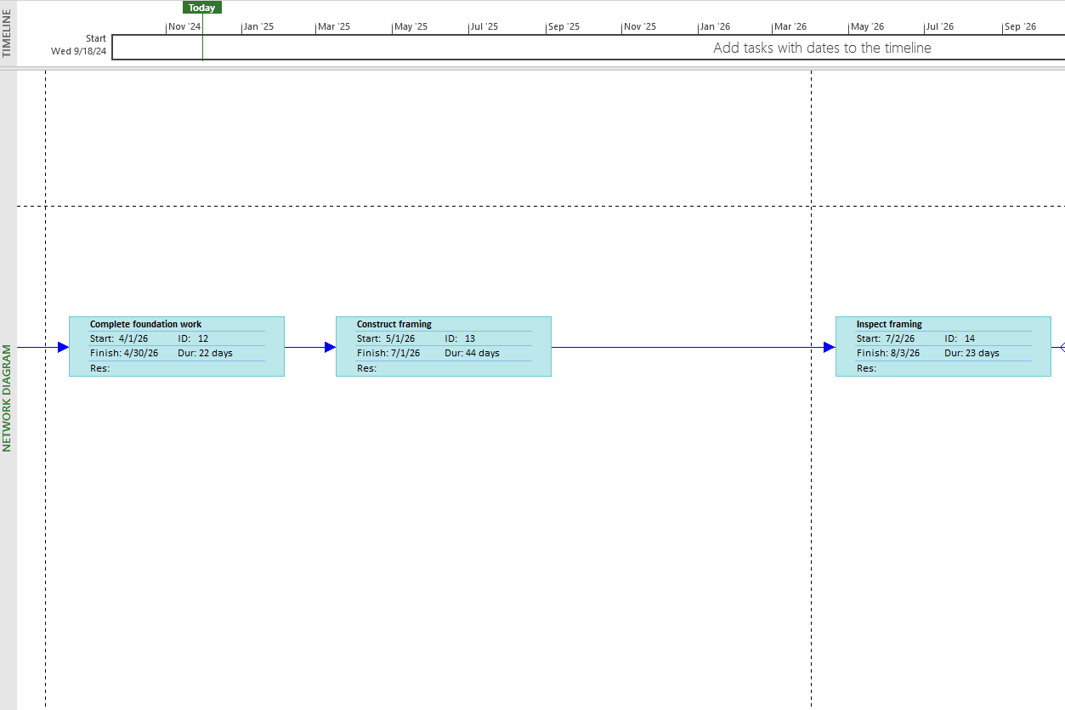
Network Analysis

Slide 18
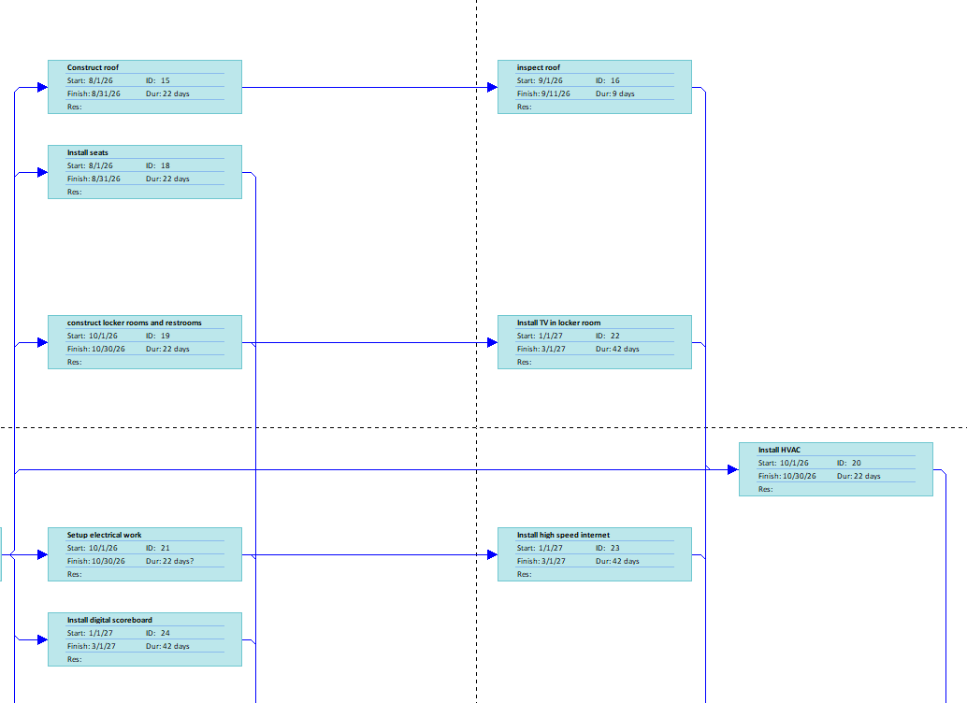
Network Analysis

Slide 19
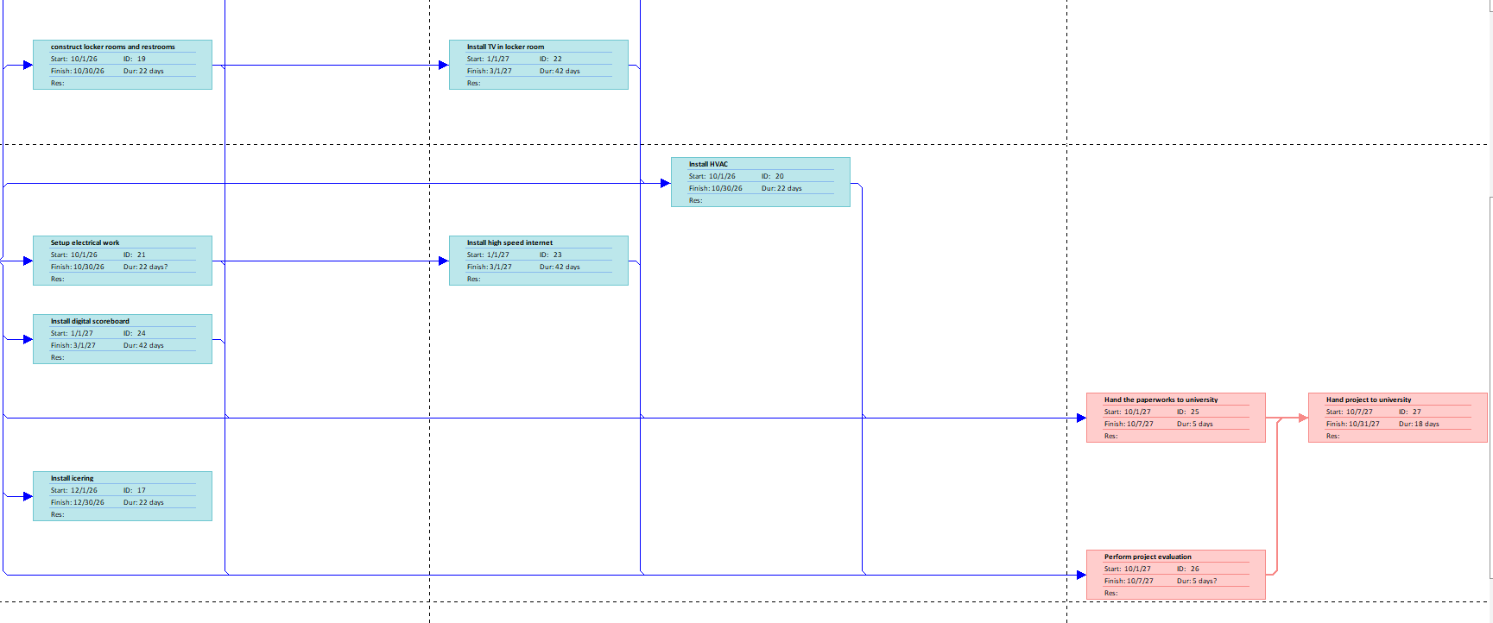
Network Analysis

Slide 20
Project Priority Matrix
 | Time | Scope | Cost
Constrain |  |  | XX
Enhance |  | XX
Accept | XX
Cost is Constrained because it has a fixed budget of $50 million.
The scope is enhanced because the project should exceed expectations.
Time is accepted as it is non-negotiable and should be completed by October 2027

Slide 21
Responsibility Matrix
Task | Sijan | Yaman
Definition | S | R
Project Plan | R | S
Construction Work | R | S
Mechanical & electrical Work | S | R
IT Infrastructure | R | S
Project closure & Testing | R | S
Legend R == Responsible S == Support

Slide 22
02
Project Plan

Slide 23
Schedule
01
03
Design Approval
Project Handover
02
04
Nov. 2025
Oct 2027
Construction Start
Grand Opening
Jan 2026
Dec. 2027

Slide 24
Budget & Resources
Budget
Staffing
$50 million with a 10% buffer.
Contractors (Everything Ice)
University support teams
Materials
IT infrastructure
Resources
Skilled labor
Materials
IT infrastructure.

Slide 25
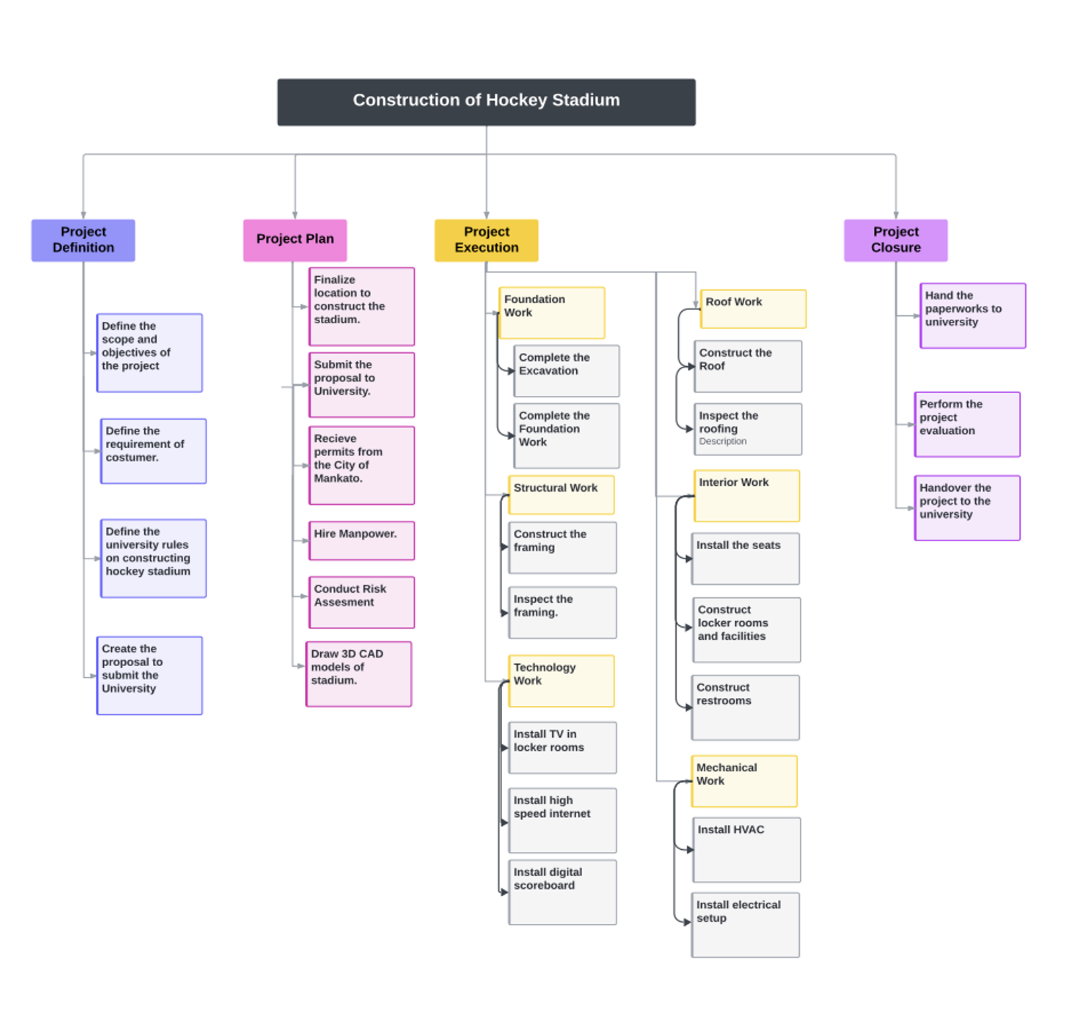
Work Break Down Structure

Slide 26
Resources
Resource Name | Type | Max. Units in percentage | Std. Rate per Hour in ($)
Civil Engineer | Work | 1200 | 65
Electrical Technician | Work | 800 | 55
HVAC Technician | Work | 600 | 60
Structural Designer | Work | 450 | 70
Legal Advisor | Work | 150 | 120
Project Manager | Work | 250 | 95
Quality Control Inspector | Work | 200 | 50
Plumber | Work | 4000 | 40
Electrician | Work | 3000 | 50

Slide 27
Project Budget
Budget Category | Estimated Cost (Millions) | Description
Labor Costs | $15 | Skilled workers, contractors, and support staff
Design and Engineering | $5 | Design team, engineering consultancy
Construction Materials | $10 | Building materials for the stadium
Cooling System (Ice Rink) | $6.5 | Equipment from Everything Ice for rink cooling
Scoreboard & Technology | $2.3 | Scoreboard setup and technology integration
Electrical Installations | $3 | Electrical systems for safety and operations
HVAC System | $2 | HVAC system for stadium air quality
Contingency Fund | $3.5 | Buffer for unexpected expenses
Total Budget: $47.3 Million

Slide 28
Risks Associated with project
Labor shortages
Weather Challenges
Overbudgeting
Insufficient workers delaying project progress.
Severe conditions halting construction activities.
Exceeding financial resources and limits.
Late Deliveries
Worker Injuries
Design Changes
Delayed materials affecting schedules.
Accidents causing downtime and lawsuits.
Last-minute alterations increasing project costs.

Slide 29
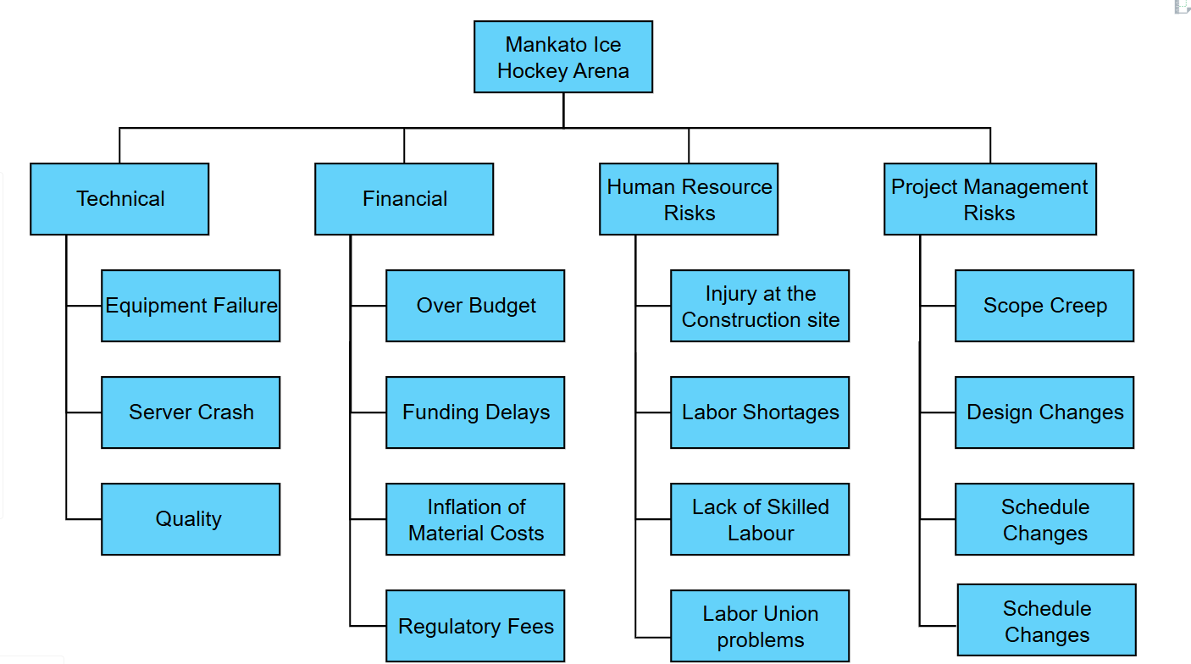
Risk Breakdown Structure

Slide 30
Risk Severity Table
Risk | Likelihood | Impact | Severity | Category
Labor Shortages | 3 | 3 | 9 | High
Design Change | 1 | 2 | 2 | Low
Weather Challenges | 2 | 2 | 4 | Medium
Over Budget | 1 | 2 | 2 | Low
Injury at site | 2 | 3 | 6 | Medium
Equipment late delivery | 1 | 2 | 2 | Low
Green → Low Risk
Yellow → Medium Risk
Red → High Risk

Slide 31
Risk Response Development
Risk Event | Response | Contingency Plan | Trigger | Who is Responsible
Equipment Failure | Mitigate: Performing regular maintenance | Making sure the backup equipment is ready | Equipment breakdown | Yaman Pandey
Project Delays | Schedule: Regularly monitoring the project's progress and milestones | Additional human resource | Tasks fall behind the scheduled date | Sijan Dahal
Labor Shortages | Mitigate: Hiring additional staff, Hiring the employee from the staffing company | Hiring contractors and backup employees ready in case someone leaves | All staff occupied; Employees left the work for good | Sijan Dahal
Weather Challenges | Acceptance Monitoring weather regularly, construction work in the summer | Pausing outdoor activities and focusing on indoor works | Extreme weather conditions in MN. Blizzards, Snowstorms | Yaman Pandey
Technology Failure | Mitigate: Patching and updating the software with the help of IT professionals | Backup system and tech support team standby | Failure of Scoreboard | Sijan Dahal
Over Budget | Mitigate: Minoring costs of the project and breaking down budgets | Reducing project scope | When the cost of the project exceeds by 20% | Yaman Pandey
Equipment Delays | Mitigate: Contact the supplier regularly for the logistics | Supply from less than 50 miles i.e. Finding local suppliers | The logistics company delays the shipment | Both

Slide 32
03
Project Execution

Slide 33
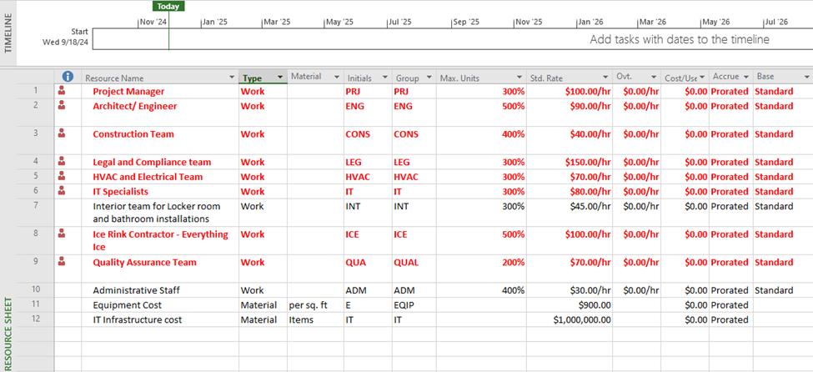
Resource Allocation – Before Levelling the Slack

Slide 34
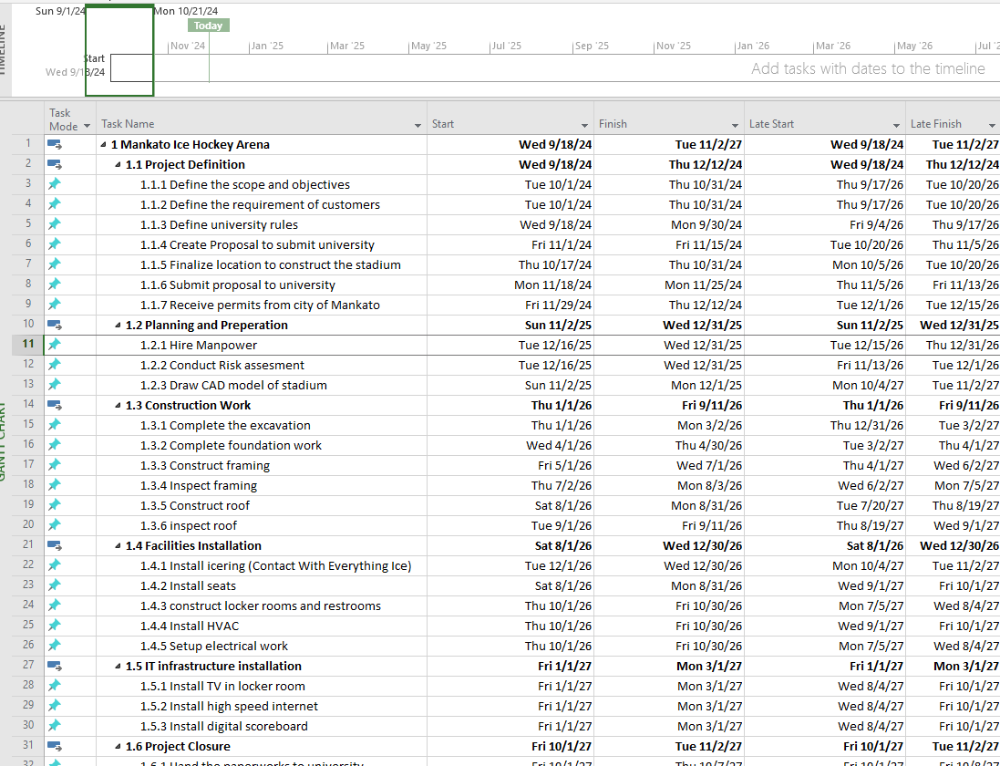
Project Timeline without Levelling the Slack

Slide 35
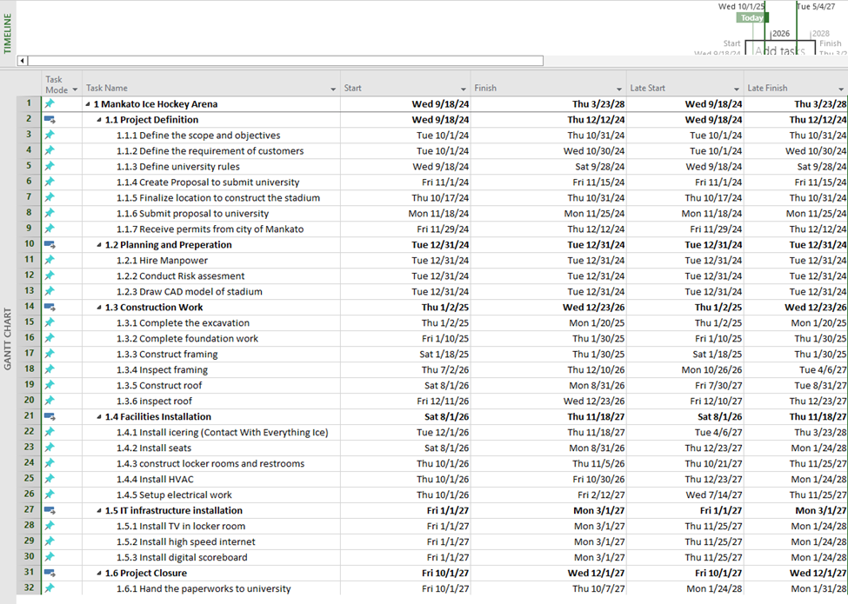
Project Timeline After Levelling the Slack

Slide 36
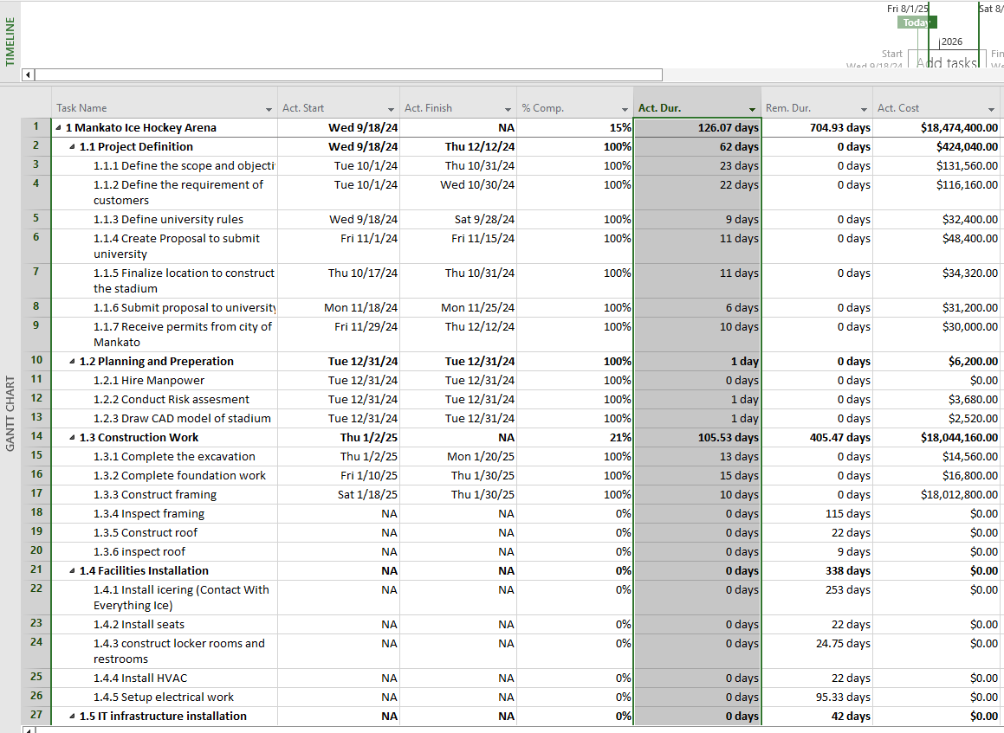
Status Report

Slide 37
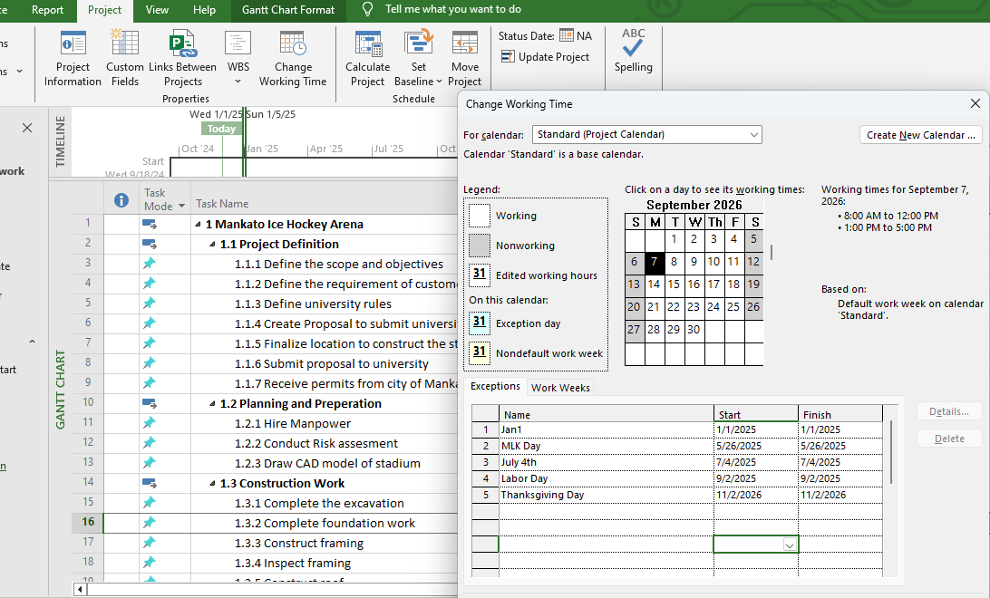
Changing Working Time In Holidays

Slide 38
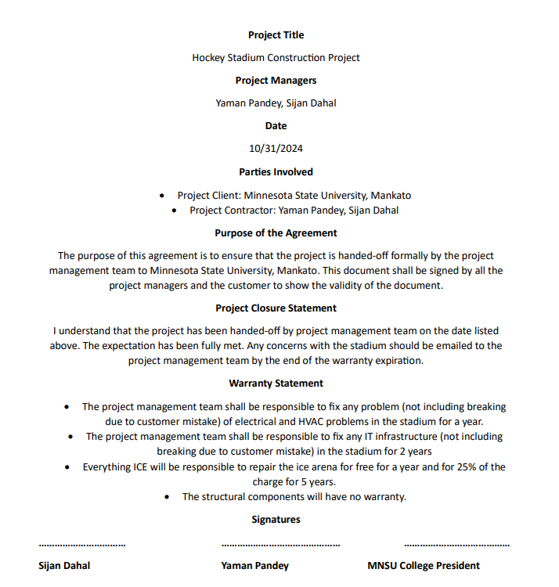
Project Closure Contract

Slide 39
ProjectAccomplishmet
Project Name: | Mankato Ice Hockey Arena
Governing Body: | Minnesota State University, Mankato
Executive Sponsor: | Minnesota State University, Mankato
Project Manager: | Sijan Dahal & Yaman Pandey
Date: | 12/11/2027
Accomplishment | Details
Mankato Arena Design Completion | The designed was done by Architecture and was approved by MSU.
Permits Secured | The necessary permits to start the construction was approved from blue earth county.
Construction Completion | The Ice Hockey arena was completed on time and within budget of $ 50 million
Operational and IT infrastructure setup | All the infrastructure such as Ice Rink, Cooling System, Digital Scoreboard have been finalized.

Slide 40
Transfer to Operations
Role | Name | Transition Date
Functional Owner | Yaman Pandey | 10/31/2027
Service Owner | Sijan Dahal | 10/31/2027
Service Manager | Yaman Pandey, Sijan Dahal | 10/31/2027

Slide 41
Project Execution
Status Reports
Changes
Weekly updates for staff, customers, and management.
Mitigating risks with contingency planning.
Quality Control
Forecasts
Standards adhered to (NHL regulations, ASHRAE specifications).
Regular tracking of milestones and resource utilization.

Slide 42
04
Project Closure

Slide 43
Project Closure
Customer Training
Documentation Transfer
Weekly updates for staff, customers, and management.
Mitigating risks with contingency planning.
Resource Release
Evaluation
Gradual handover of equipment and facilities.
Post-project review for lessons learned and feedback collection.

Slide 44
2D CAD Model

Slide 45
Lesson Learned
Cross-functional collaboration is best for project management
Communication gap can cause the project to fail

Slide 46
THANK YOU
Any Questions?

